Slide 1
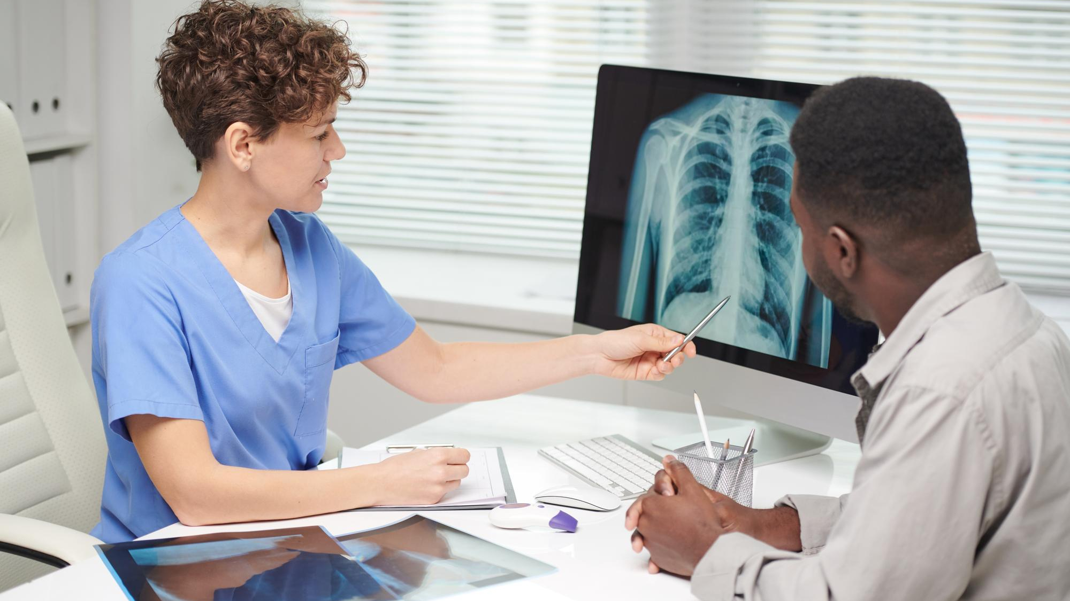
Assessing CNN Robustness in
Medical Imaging Systems:
Adversarial Threats and
Defensive Measures
Group ID : 24-25J-079
Progress Presentation I

Slide 2
Overall Introduction
Medical imaging systems diagnose diseases using machine learning models, aiding in healthcare decisions.
These systems are vulnerable to adversarial attacks that subtly alter input images.
Adversarial attacks can change predictions, causing misdiagnosis and compromising patient safety.
Robust defense strategies are essential to ensure the reliability and security of these systems.

Slide 3
Overall Research Gap
There is a lack of comprehensive evaluation of how adversarial attacks impact CNN-based medical imaging systems.
Existing defense mechanisms have not been thoroughly tested for their effectiveness across diverse attack types and model architectures.
This gap is particularly significant for chest X-ray classification, where robustness is critical for reliable and secure diagnostics.

Slide 4
Overall Objectives
Investigate Adversarial Attacks
1
Implement and analyze the impact of various adversarial attacks, including Style Transfer Manipulation (STM), Penalizing Gradient Norm (PGN), Structure Invariant Attack (SIA), and Uniform Scale Mix Mask (USMM), on CNN models used for chest X-ray classification.
2
Evaluate Model Robustness
Assess the robustness of the ResNet CNN model against the identified adversarial attacks using performance metrics such as accuracy, precision, recall, and F1-score.
3
Test and Validate Défense Strategies
Test and validate the effectiveness of existing defense mechanisms, including data augmentation and adversarial training, in counteracting the effects of adversarial attacks on ResNet CNN model.
Measure Defense Effectiveness
4
Evaluate the performance of defense strategies in enhancing or failing to enhance the resilience of ResNet CNN model against adversarial attacks, ensuring reliable performance on both clean and adversarial datasets

Slide 5
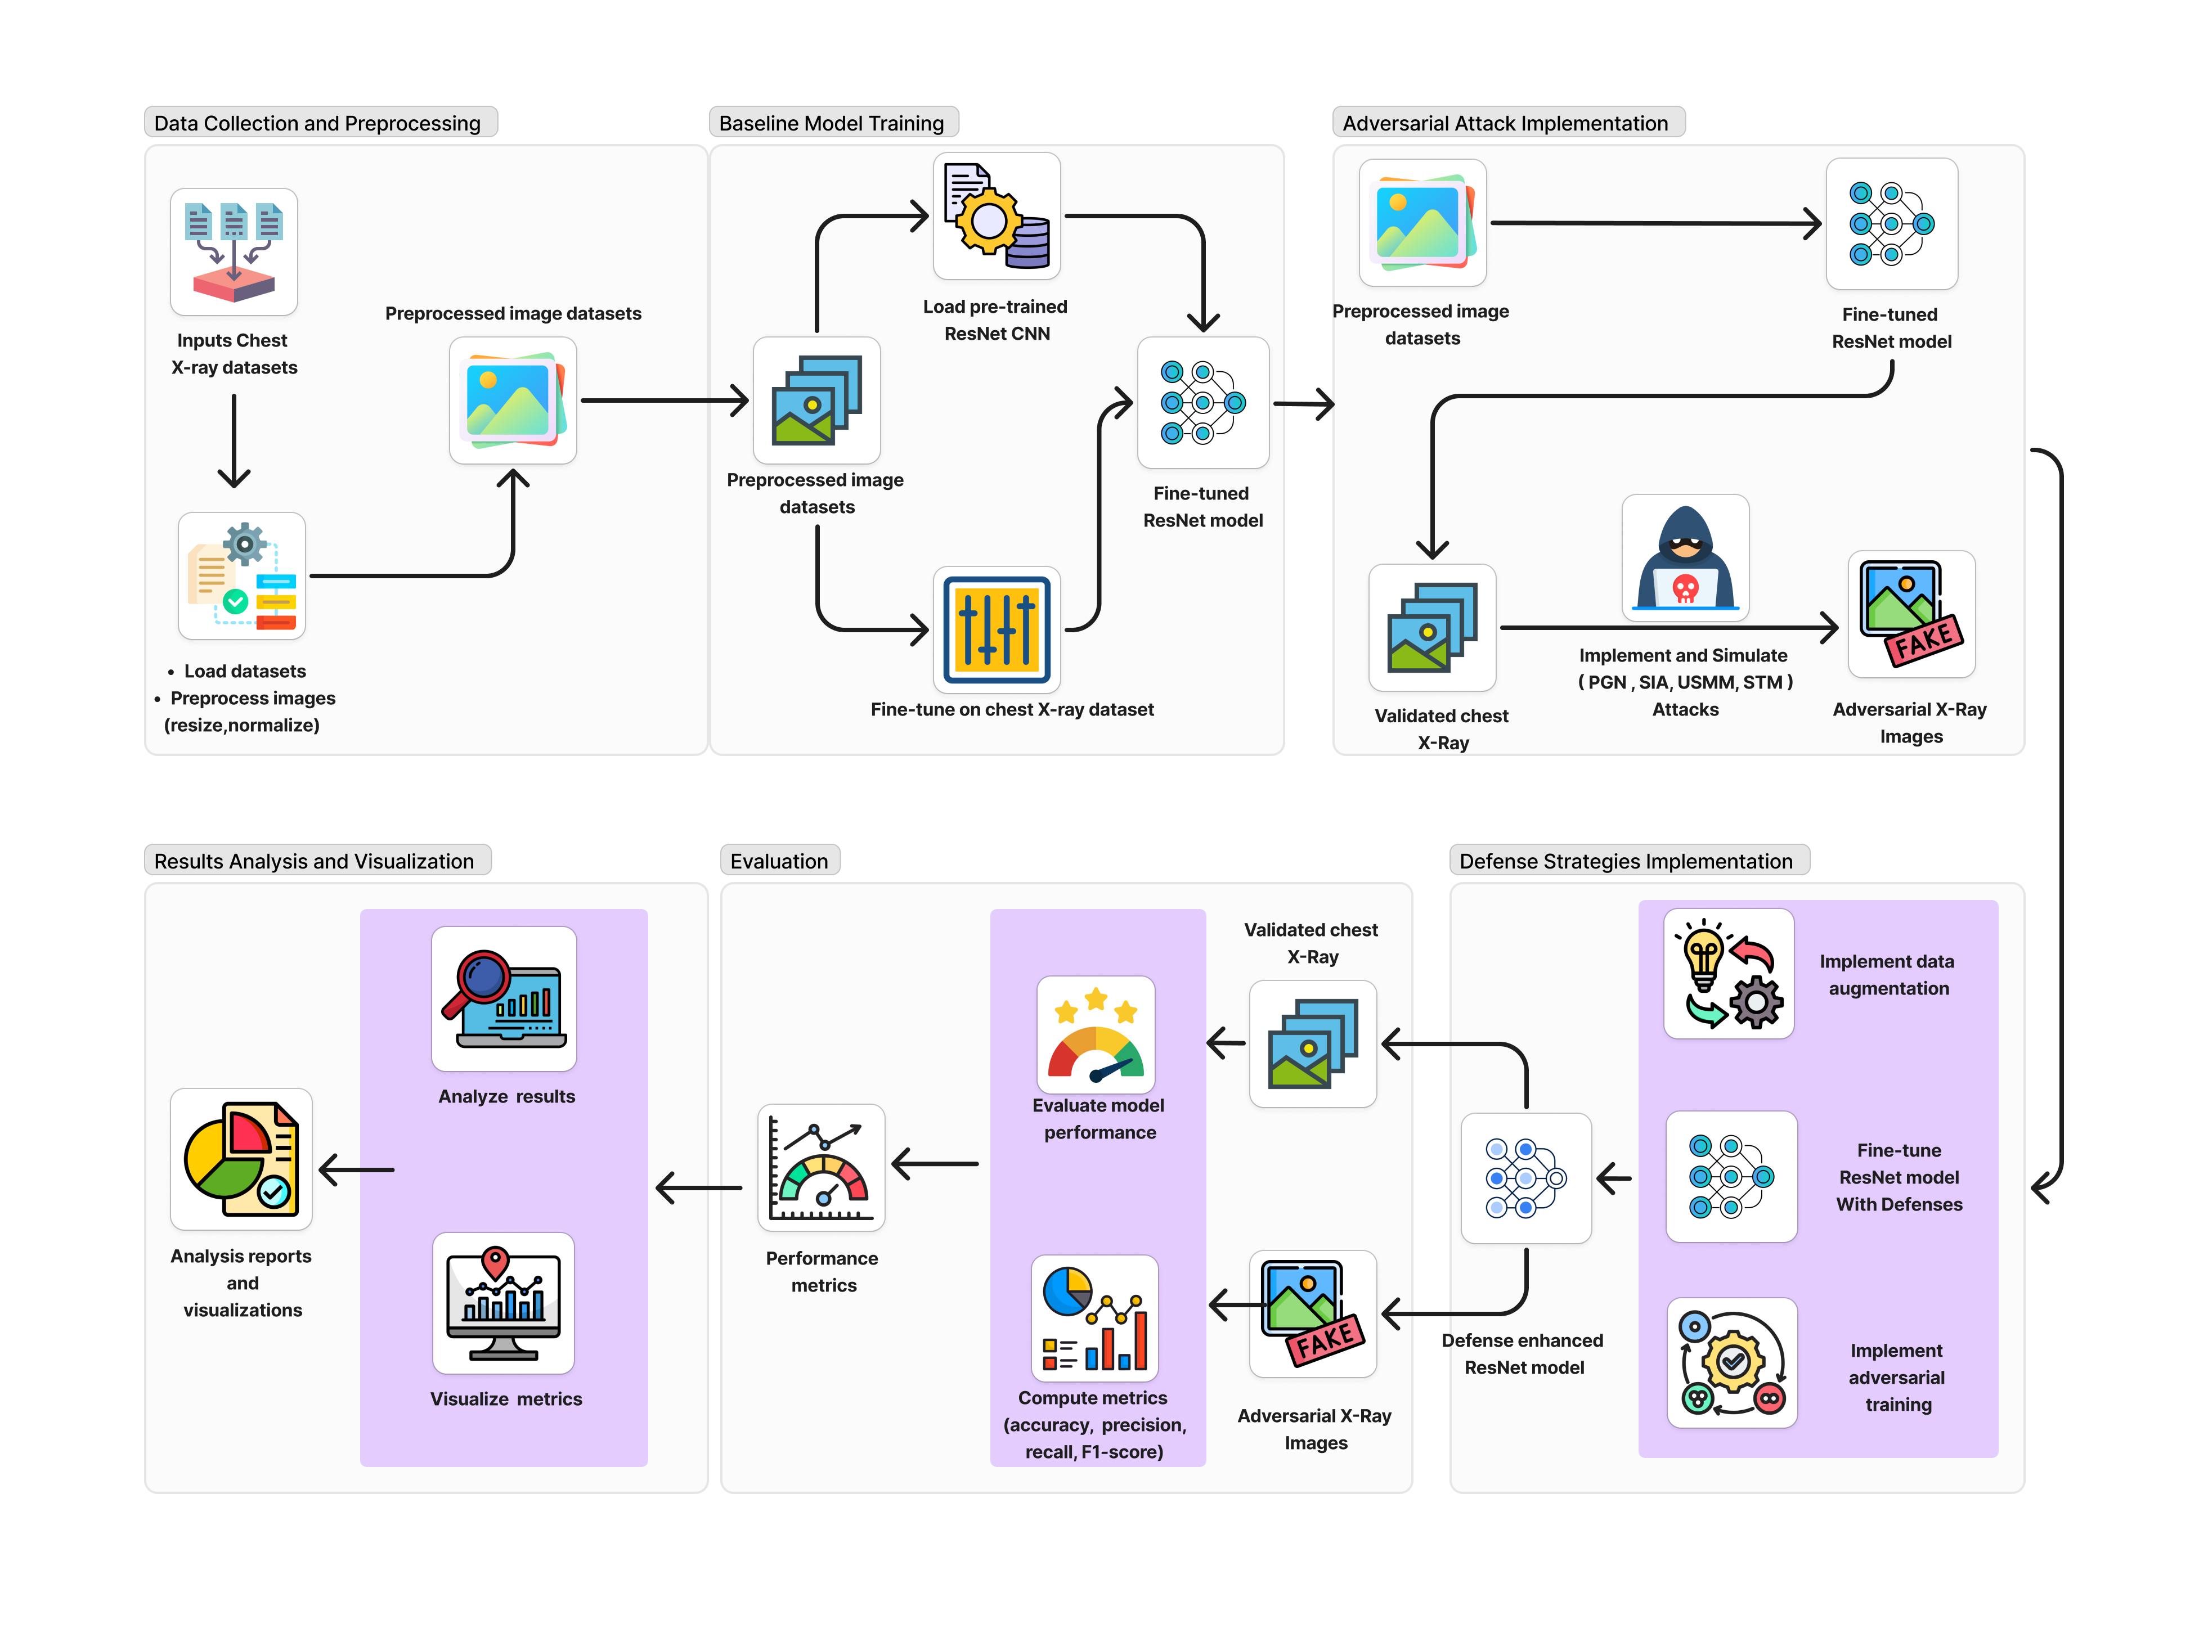
Overall System Diagram

Slide 6
CNN Models

Slide 7
ResNet50
ResNet50 introduces the concept of residual blocks, which allow the model to learn residual mappings instead of directly trying to map inputs to outputs. This helps in avoiding the vanishing gradient problem during backpropagation in very deep networks
Key Reason:
To address the vanishing gradient problem in deep networks while maintaining high accuracy.
Introduces residual learning with skip connections, allowing deeper networks without degradation in performance.
Highly effective for complex datasets like chest X-rays due to its ability to extract high-level features.
Relevance to the project: Acts as a baseline for evaluating adversarial attacks on a widely used robust architecture.

Slide 8
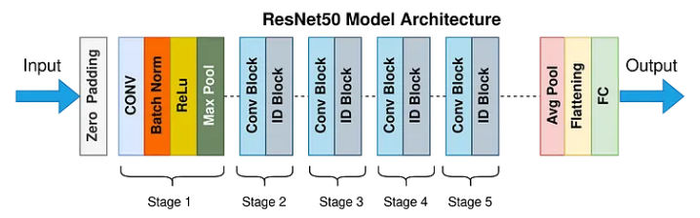

ResNet50 Architecture
Input: The input layer takes an image with dimensions 224x224 pixels.
Convolutional Layers: These layers apply numerous filters to the input to create feature maps that abstract the input data.
Pooling Layers: Used between convolutional layers, pooling reduces the dimensionality of each feature map but retains the most important information.
Residual Blocks: Each block has convolutional layers with batch normalization and ReLU activation, followed by a skip connection that adds the input of the block to its output.
Output: A global average pooling layer followed by a fully connected layer that maps the features learned by the network into the final output classes.

Slide 9
DenseNet121
DenseNet121 uses dense blocks where each layer is directly connected to every other layer within the same block. This ensures maximum feature reuse and minimizes redundant computation.
Key Reason:
Encourages feature reuse by connecting each layer to all subsequent layers in the dense block.
Reduces the risk of overfitting while using fewer parameters than other architectures.
Relevance to the project: Ideal for testing adversarial robustness as it handles feature perturbations better due to its efficient learning structure.

Slide 10
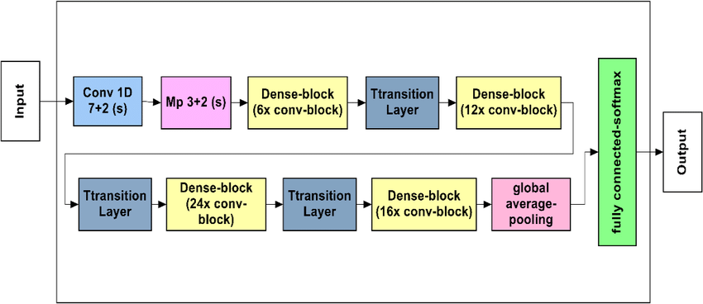
DenseNet121 Architecture
Input Layer: DenseNet121 takes an input image of size 224x224 pixels.
Dense Blocks and Transition Layers:
Dense Blocks: These blocks contain several convolutional layers, where each layer is connected to every other layer in the block. Each layers consists of batch normalization, a ReLU activation function, and a convolutional layer.
Transition Layers: Positioned between dense blocks, these layers do convolution and pooling.
Global Average Pooling and Output: After the last dense block, a global average pooling layer reduces the spatial dimensions to 1x1.

Slide 11
VGGNet19
VGGNet19 is a deep convolutional neural network known for its simple and uniform architecture, consisting of 19 layers of convolutional and fully connected layers. It uses small 3x3 convolution filters stacked deeply, enabling it to capture fine-grained features in images while maintaining computational efficiency
Key Reason:
Consists of uniform 3x3 convolutional layers, making it easy to understand and analyze.
Demonstrates strong performance despite being one of the older architectures.
Relevance to the project: Provides a comparison point to measure the robustness and effectiveness of advanced models like ResNet and DenseNet.

Slide 12
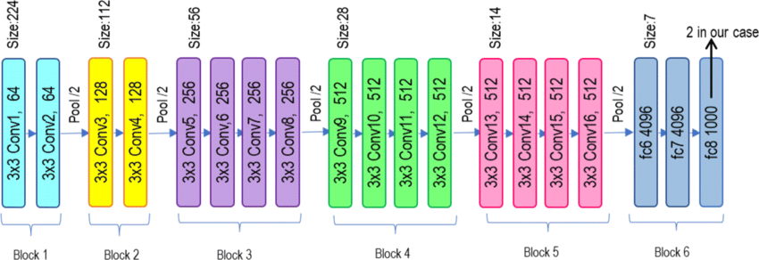
VGGNet19 Architecture
Input Layer: Accepts images of size 224x224x3.
Convolutional Layers: Contains 16 convolutional layers, all using 3x3 filters with stride 1 and padding to retain spatial dimensions. Each layer is followed by a ReLU activation functio.
Pooling Layers: A 2x2 max-pooling layer with stride 2 is applied after every 2-3 convolutional layers, progressively reducing spatial dimensions while retaining key features.
Fully Connected Layers: Includes three fully connected (FC) layers.
Output Layer: Utilizes a softmax activation function to produce probabilities for each class.

Slide 13
InceptionV3
InceptionV3 is a deep convolutional neural network designed for efficient and accurate image classification. It uses advanced Inception modules, which combine multiple filter sizes to capture diverse features, and employs techniques like factorized convolutions and batch normalization to optimize computational efficiency.
Key Reason:
Uses Inception modules that combine filters of different sizes (1x1, 3x3, 5x5), capturing both local and global features.
Incorporates auxiliary classifiers to prevent vanishing gradients.
Optimizes computational resources with factorized convolutions.
Relevance to the project: Well-suited for medical imaging due to its ability to detect subtle anomalies across varying image resolutions and scales.

Slide 14
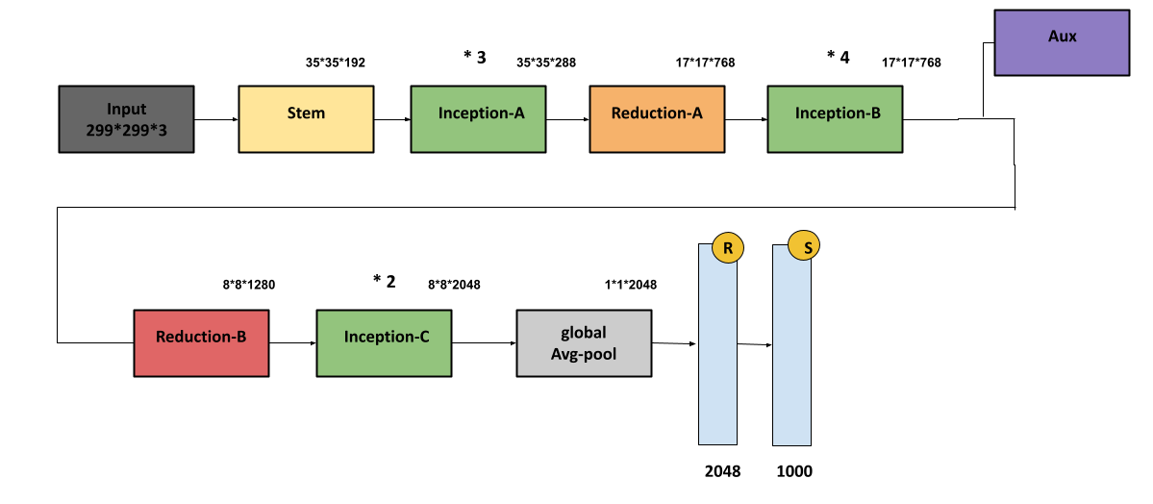
InceptionV3 Architecture
Input Layer: Accepts images of size 299x299x3.
Convolutional Layers: Initial layers perform feature extraction using traditional convolutions and max pooling.
Inception Modules: Stacks multiple Inception modules, each combining filters of different sizes and pooling layers.
Auxiliary Classifiers: Two auxiliary classifiers are added before the final output, acting as regularizers.
Output Layer: A softmax classifier provides probabilities for each class

Slide 15
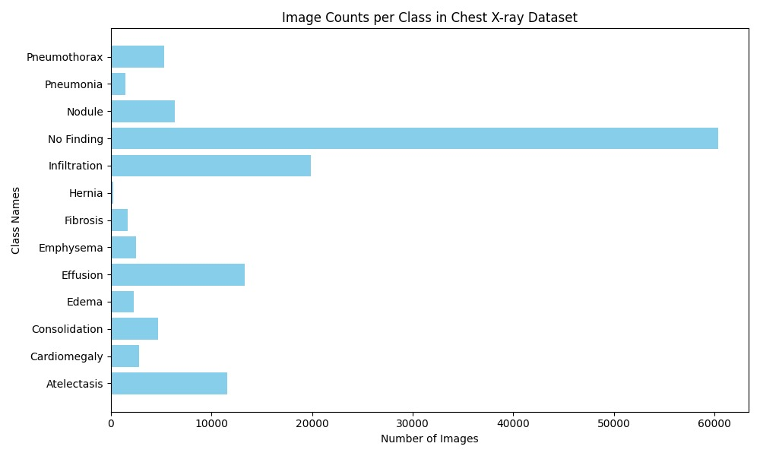
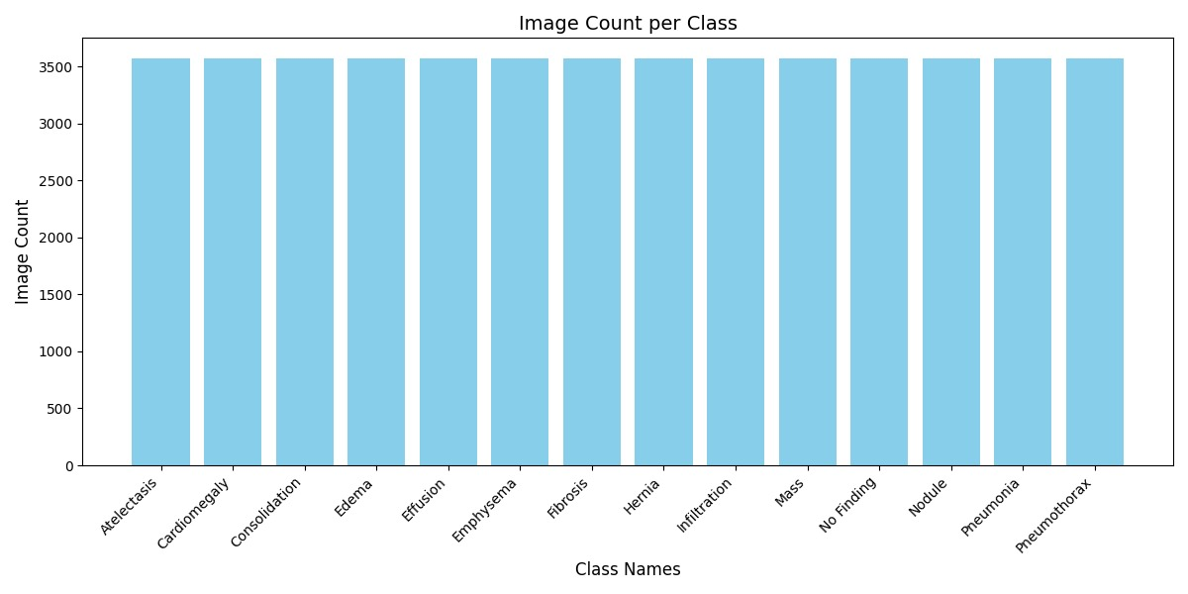
Dataset
Dataset Selection: Chest X-ray
Number of images: 112,120 X-ray images
Number of Classes: 14
Normalization: Data Augmentation
Before Data Augmentation
After Data Augmentation

Slide 16

IT21197550
Nihila Premakanthan
Cyber Security

Slide 17
Robustness Evaluation of CNN Against Style Transfer Manipulation (STM) Adversarial Attack
1
Introduction
2
Research Problem
3
Objectives
4
Literature Review
5
Methodology
5
Current Progress

Slide 18
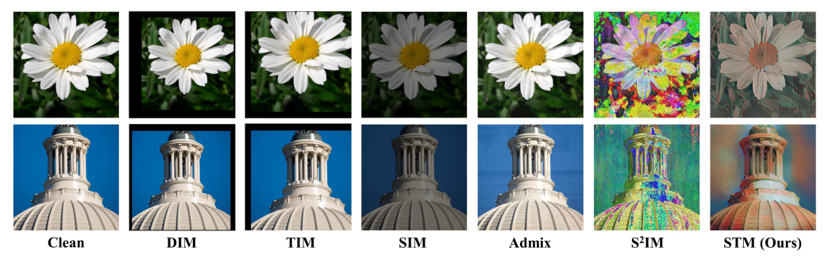
Introduction
What is STM Attack?
STM (Style Transfer Manipulation) attack is a type of adversarial attack where the style of an image, such as its textures and colours, is subtly changed.
Parameters Changed:
1. Color Distribution
2. Texture
3. Spatial Features
4. Local and Global Contrast:
5. High-Level Semantic Features:
6. Noise Patterns

Slide 19
Research Gap
Lack of comprehensive evaluation of how Style Transfer Manipulation attacks impact CNN-based medical imaging systems.
Existing defense mechanisms have not been thoroughly tested for their effectiveness Style Transfer Manipulation attacks and model architectures.

Slide 20

Research Problem
How effective are existing defense strategies in enhancing the robustness of CNN models used for chest X-ray classification against STM attacks?
How can these defense strategies be tested and validated to ensure reliable and secure medical diagnostics?

Slide 21
Objectives
1
Fine-Tune CNN
2
Implement STM Attack
Fine-tune the Resnet50 CNN models to evaluate their performance under STM attack conditions.
Develop and apply the Style Transfer Method (STM) attack on chest X-ray datasets using CNN model.
3
Evaluate Performance Metrics
4
Test Defence Strategies
Assess the impact of STM attacks on model performance using metrics such as accuracy, precision, recall, and F1-score.
Test existing defense strategies, such as data augmentation and adversarial training, to mitigate the effects of STM attacks on CNN models.
5
Validate Defence Effectiveness
Validate the effectiveness of the defense strategies by comparing model performance on clean and adversarial datasets.

Slide 22
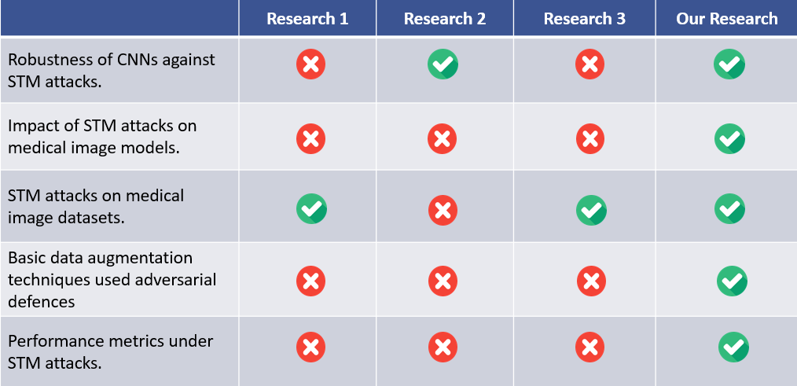
Literature Review

Slide 23
Methodology
System Diagram
1
2
Technologies
3
4
Defense Strategies
Attack Method

Slide 24
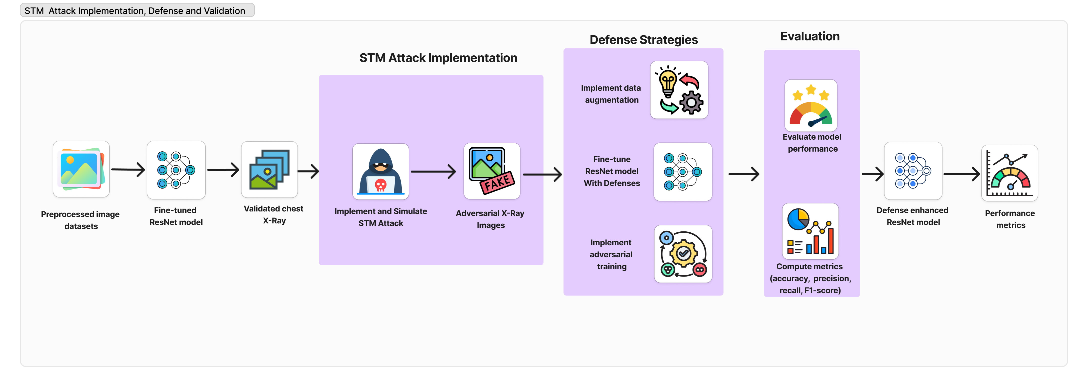
System Diagram

Slide 25

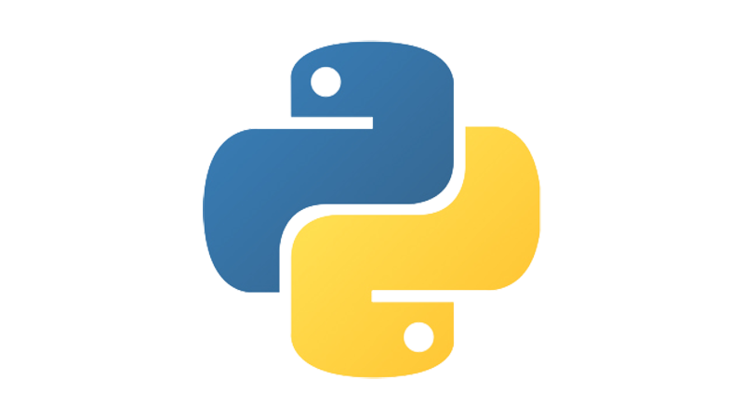





Tools and Technologies
DL Frameworks
Model Architectures
TensorFlow
ResNet50
DenseNet121
VGG19
Inception V3
Programming Lang.
Data Management Tools
Visualization Tools
Python
Pandas
NumPy
Matplotlib
Evaluation Metrics
IDE & Compute Resources
Scikit-learn
Google Colab

Slide 26
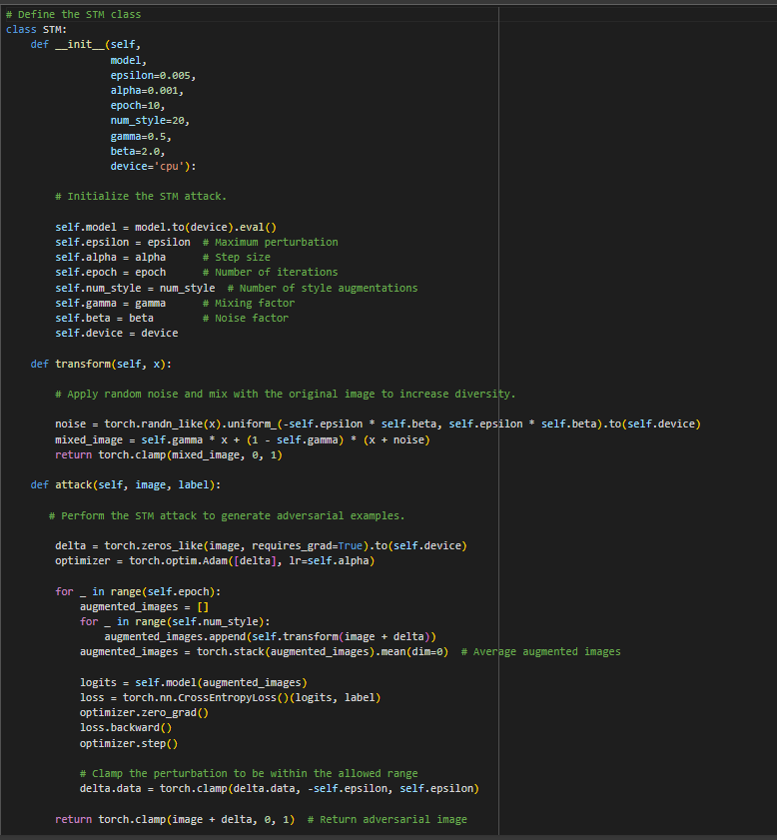
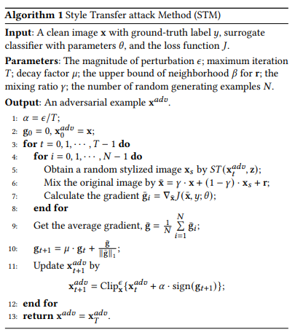

Attack Method – STM
1
5
2
3
Dr.Bakron
4
7
6
8
9
10

Slide 27
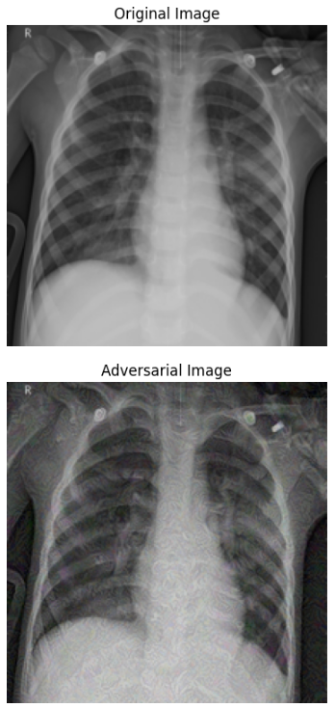
Attack Method – STM

Slide 28
Current Progress
1
Data Preprocessing
Image Preprocessing: Resized all images to the input size required by the model (e.g., 224x224 for ResNet50)
Data Augmentation: Applied various augmentation techniques to improve model generalization
2
2
Model Setup
Model Setup
Trained Resnet50 (pretrained on ImageNet) to leverage powerful feature extraction capabilities.
Trained Resnet50 (pretrained on ImageNet) to leverage powerful feature extraction capabilities.
3
Attack Simulation
Simulated STM attack on CNN and shown misclassification after the attack.

Slide 29

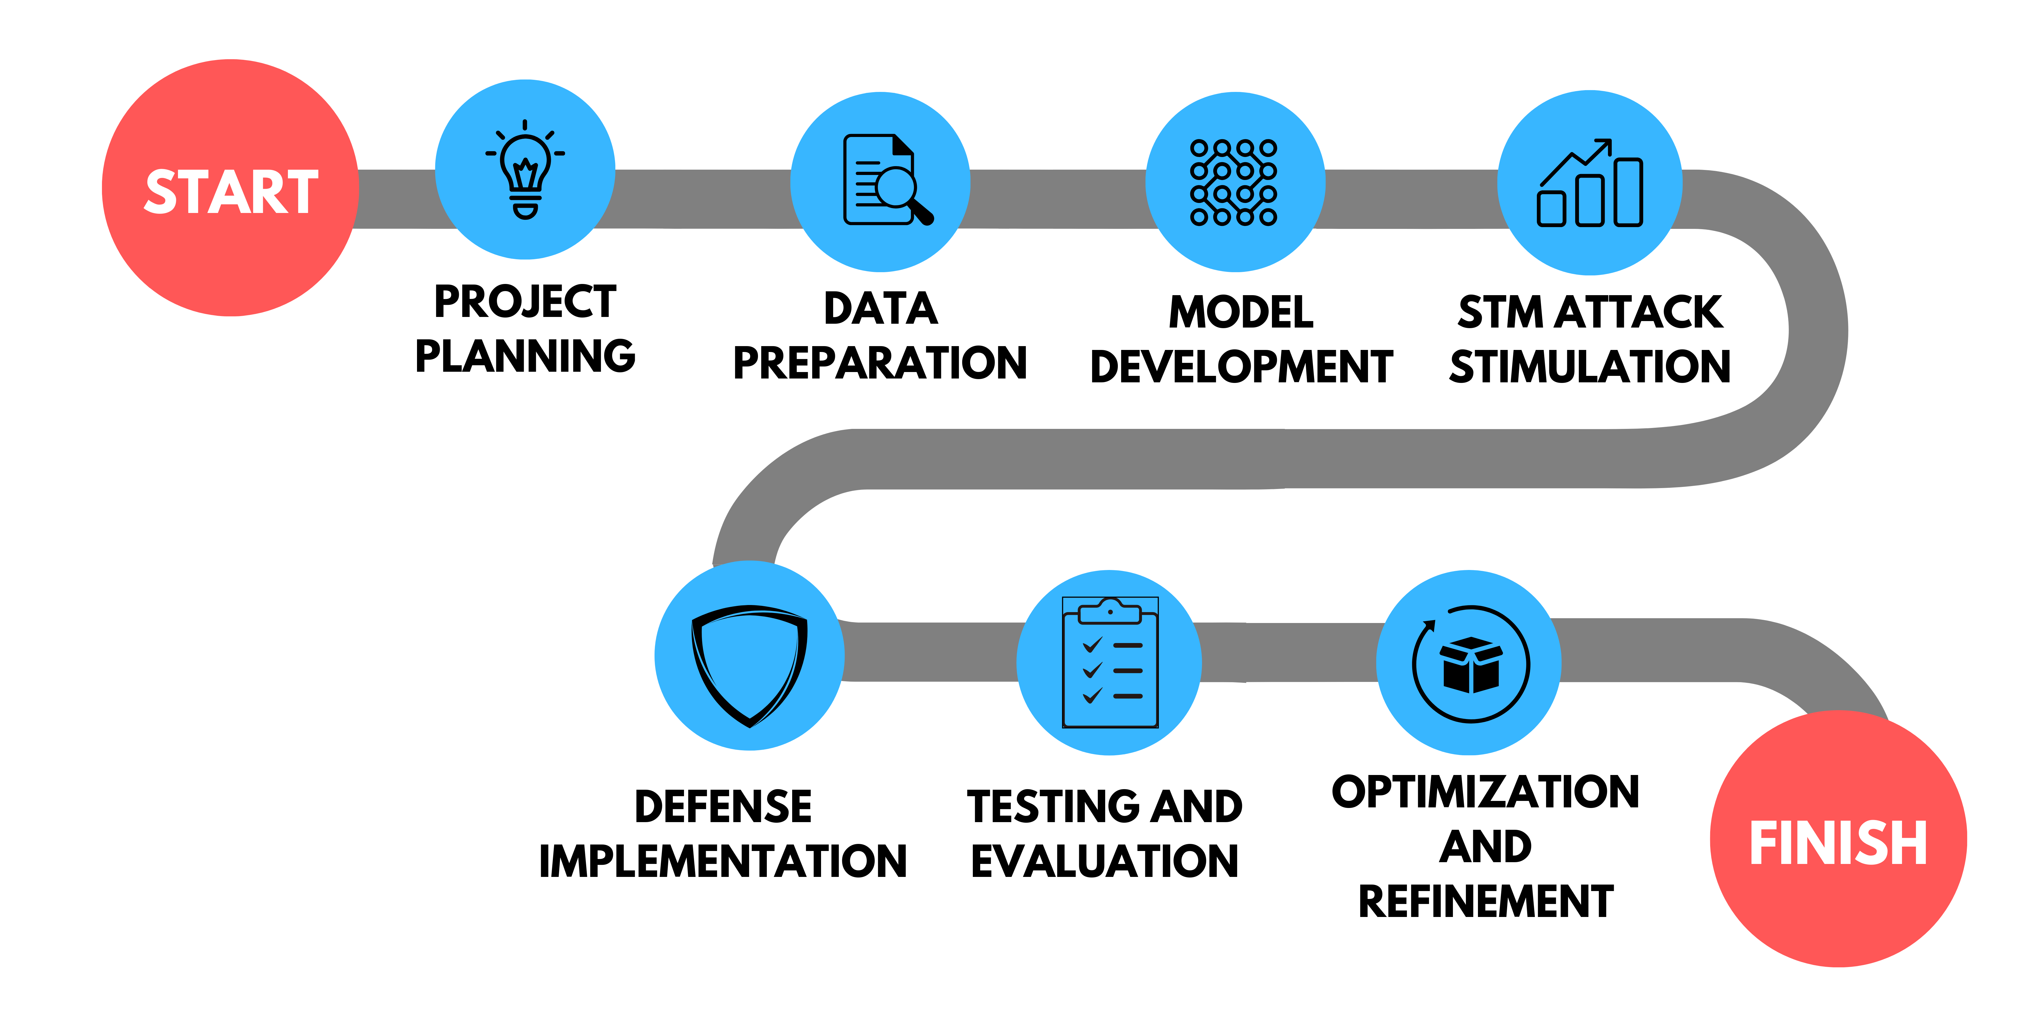
Project Completion

Slide 30
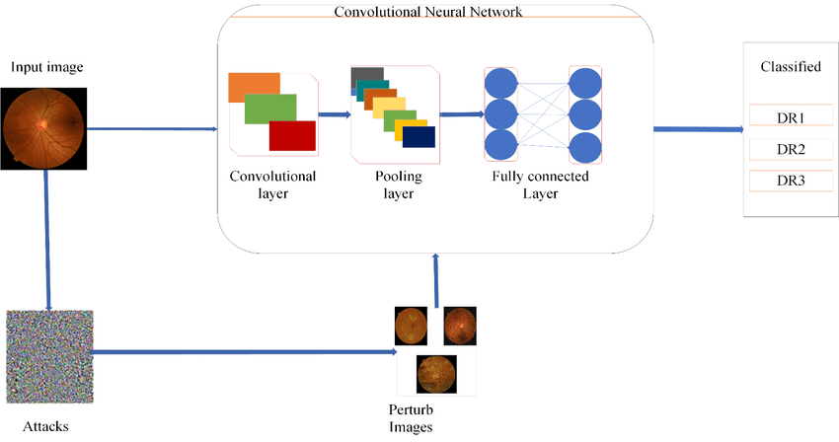
Defence Strategies
Adversarial Training (AT)
Histogram Gradient Descent (HGD)
Randomized Smoothing (RS)
Randomized Noise Reduction and
Preprocessing (NRP)

Slide 31
References
[1] Zhilu Zhang, Xi Yang, and Kaizhu Huang, "Attacking Sequential Learning Models with Style Transfer Based Adversarial Examples," Journal of Physics: Conference Series, vol. 1880, 2021. doi: 10.1088/1742-6596/1880/1/012021.
[2] Qiuling Xu, Guanhong Tao, Siyuan Cheng, and Xiangyu Zhang, "Towards Feature Space Adversarial Attack by Style Perturbation," in Proceedings of the AAAI Conference on Artificial Intelligence, vol. 35, no. 10, pp. 10523-10530, May 2021. Available: https://arxiv.org/abs/2004.12385.
[3] Zhilu Zhang, Xi Yang, and Kaizhu Huang, "Improving the Transferability of Adversarial Examples with Arbitrary Style Transfer," Journal of Physics: Conference Series, vol. 1880, 2021. Available: https://iopscience.iop.org/article/10.1088/1742-6596/1880/1/012021.

Slide 32

IT21155802
D.S.C. Wijesuriya
Cyber Security

Slide 33
Assessing CNN Resilience to Penalizing Gradient Norm (PGN) Adversarial Attack
1
Introduction
2
Research Problem
3
Objectives
4
Literature Review
5
Methodology
5
Current Progress

Slide 34
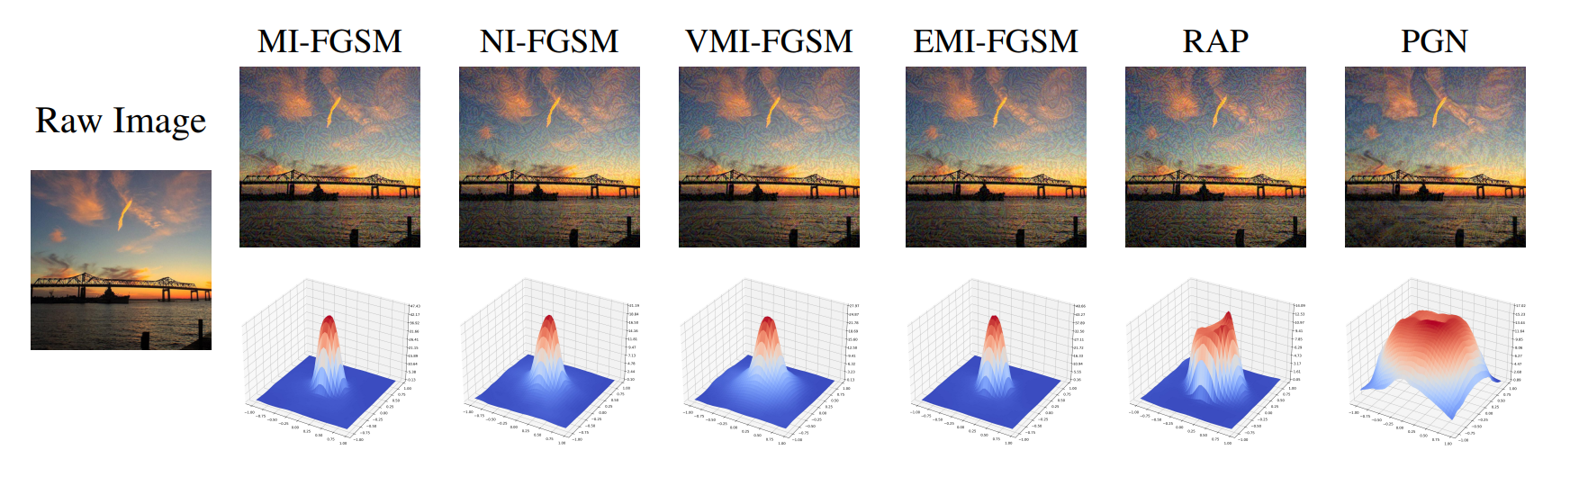
Introduction
What is PGN Attack?
The Penalizing Gradient Norm (PGN) attack is a type of adversarial attack that increases the sensitivity of neural network models to small perturbations in the input data.

Slide 35
Research Gap
Lack of comprehensive evaluation of how Penalizing Gradient Norm (PGN) Attacks impact CNN-based medical imaging systems.
Existing defense mechanisms have not been thoroughly tested for their effectiveness Penalizing Gradient Norm (PGN) attacks and model architectures with medical imaging.

Slide 36

Research Problem
How effective are existing defense strategies in enhancing the robustness of CNN model used for chest X-ray classification PGN adversarial attacks?
How can these defense strategies be tested and validated to ensure reliable and secure medical diagnostics?

Slide 37
Objectives
1
Fine-Tune CNN
2
Implement PGN Attack
Fine-tune the InceptionV3 CNN models to evaluate their performance under PGN attack conditions.
Develop and apply the Penalizing Gradient Norm (PGN) attack on chest X-ray datasets using CNN model.
3
Evaluate Performance Metrics
4
Test Defence Strategies
Assess the impact of PGN attacks on model performance using metrics such as accuracy, precision, recall, and F1-score.
Test existing defense strategies, such as data augmentation and adversarial training, to mitigate the effects of PGN attacks on CNN models.
5
Validate Defence Effectiveness
Validate the effectiveness of the defense strategies by comparing model performance on clean and adversarial datasets.

Slide 38
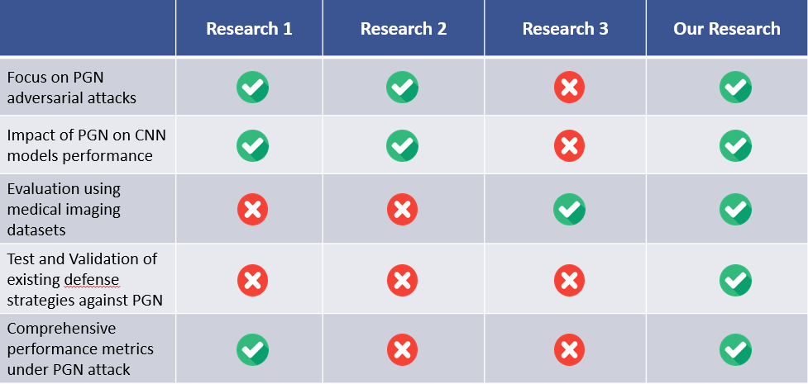
Literature Review

Slide 39
Methodology
System Diagram
1
2
Technologies
3
4
Defense Strategies
Attack Method

Slide 40
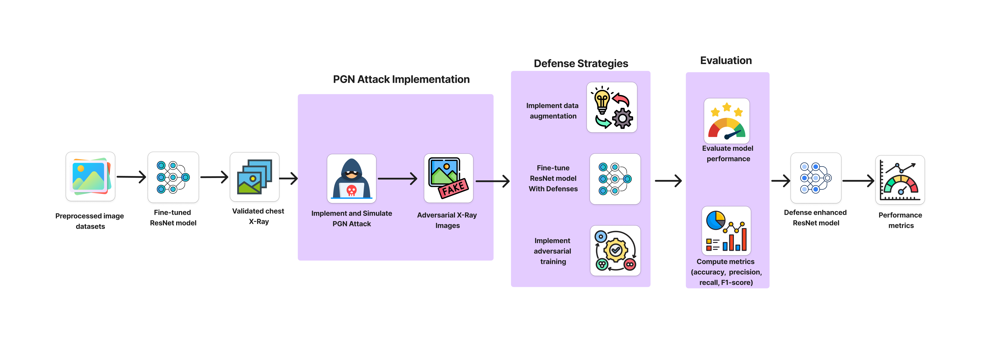
System Diagram

Slide 41
Tools and Technologies
DL Frameworks
Model Architectures
TensorFlow
ResNet50
DenseNet121
VGG19
Inception V3
Programming Lang.
Data Management Tools
Visualization Tools
Python
Pandas
NumPy
Matplotlib
Evaluation Metrics
IDE & Compute Resources
Scikit-learn
Google Colab

Slide 42
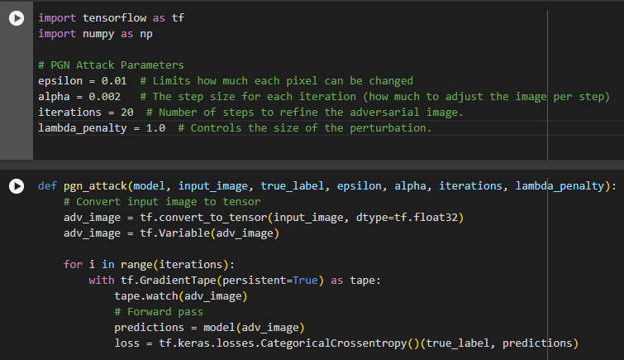
Attack Method – PGN
Model
Input Image
True Label
Epsilon: Maximum Perturbation
Alpha: Step Size
Iterations: Number of Iterations
Lambda Penalty: Gradient penalty coefficient
Dr.Bakron

Slide 43
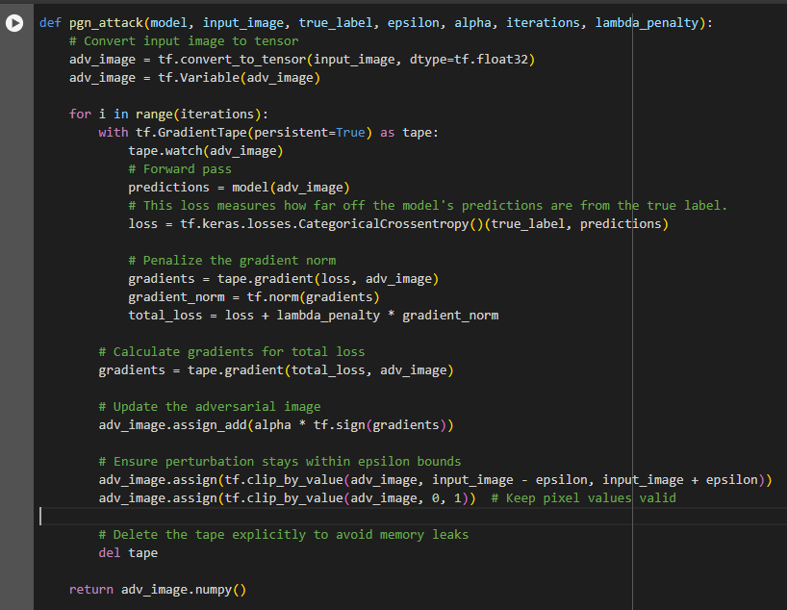
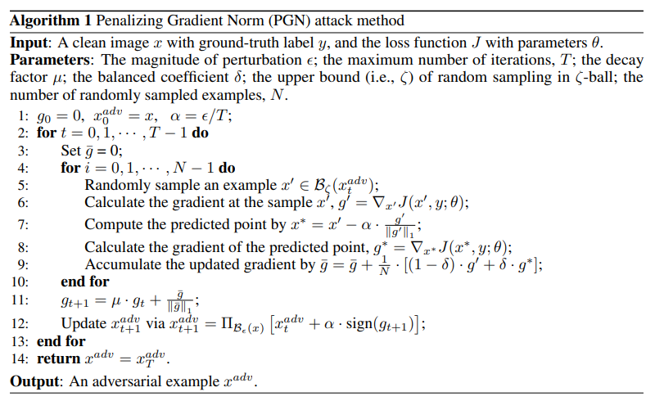
1
2
3
4
5
Dr.Bakron
6

Slide 44
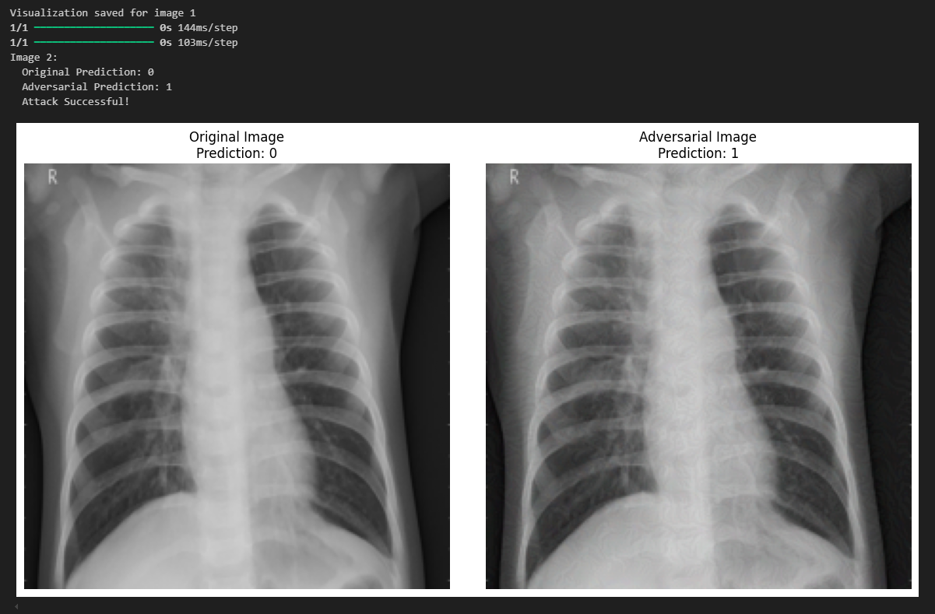
Dr.Bakron

Slide 45
Defence Strategies
Adversarial Training (AT)
Histogram Gradient Descent (HGD)
Randomized Smoothing (RS)
Randomized Noise Reduction and
Preprocessing (NRP)

Slide 46
Current Progress
1
Data Preprocessing
Image Preprocessing: Resized all images to the input size required by the model (e.g., 299x299 for Inception V3)
Data Augmentation: Applied various augmentation techniques to improve model generalization
2
2
Model Setup
Model Setup
Trained Resnet50 (pretrained on ImageNet) to leverage powerful feature extraction capabilities.
Trained Inception V3 (pretrained on ImageNet) to leverage powerful feature extraction capabilities.
3
Attack Simulation
Simulated PGN attack on CNN and shown misclassification after the attack.

Slide 47

Project Completion

Slide 48
References
[1] Z. Ge, H. Liu, X. Wang, F. Shang, and Y. Liu, "Boosting Adversarial Transferability by Achieving Flat Local Maxima," Neural Information Processing Systems (NeurIPS 2023), arXiv:2306.05225, Nov. 2023. [Online]. Available: https://arxiv.org/abs/2306.05225
[2] Li, Xiangjuan & Li, Feifan & Li, Yang & Pan, Quan. (2023). PGN: A Perturbation Generation Network Against Deep Reinforcement Learning. 611-618. 10.1109/ICTAI59109.2023.00096.
[3] J. Dong, J. Chen, X. Xie, J. Lai, and H. Chen, "Adversarial Attack and Defense for Medical Image Analysis: Methods and Applications," arXiv, arXiv:2303.14133, Mar. 2023. [Online]. Available: https://doi.org/10.48550/arXiv.2303.14133

Slide 49

IT21166860
P.G.E.J. Sandamal
Cyber Security

Slide 50
Robustness Evaluation of CNN Against Structure Invariant Attack (SIA) Adversarial Attack
1
Introduction
2
Research Problem
3
Objectives
4
Literature Review
5
Methodology
6
Current Progress

Slide 51
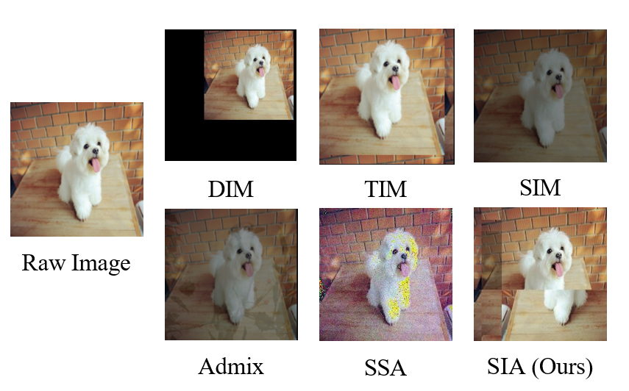
Introduction
What is SIA Attack?
The Structure Invariant Attack (SIA) attack divides an image into blocks and applies transformations to deceive CNNs, causing misclassification. It exploits CNNs' spatial consistency, posing threats to AI systems, especially in medical imaging.

Slide 52

Research Problem
How effective are existing defence strategies in enhancing the robustness of CNN models used for chest X-ray classification against SIA attacks?
How can these defence strategies be tested and validated to ensure reliable and secure medical diagnostics?

Slide 53
Research Gap
Lack of comprehensive evaluation of how Structure Invariant Attack (SIA) impact CNN-based medical imaging systems.
Existing defense mechanisms have not been thoroughly tested for their effectiveness Structure Invariant Attack (SIA) and model architectures.
Currently not verify this attack on Medical Images

Slide 54
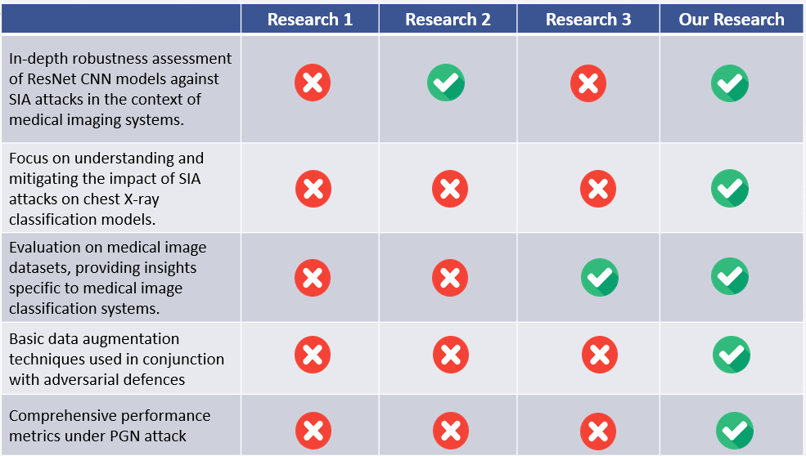
Literature Review

Slide 55
Objectives
1
Fine-Tune CNN
2
Implement SIA Attack
Fine-tune the DenseNet121 CNN models to evaluate their performance under SIA attack conditions.
Develop and apply the SIA attack on chest X-ray datasets using CNN model.
3
Evaluate Performance Metrics
4
Test Defence Strategies
Assess the impact of SIA attacks on model performance using metrics such as accuracy, precision, recall, and F1-score.
Test existing defense strategies, such as data augmentation and adversarial training, to mitigate the effects of SIA attacks on CNN models.
5
Validate Defence Effectiveness
Validate the effectiveness of the defense strategies by comparing model performance on clean and adversarial datasets.

Slide 56
Methodology
System Diagram
1
2
Technologies
3
4
Defense Strategies
Attack Method

Slide 57

System Diagram

Slide 58
Tools and Technologies
DL Frameworks
Model Architectures
TensorFlow
ResNet50
DenseNet121
VGG19
Inception V3
Programming Lang.
Data Management Tools
Visualization Tools
Python
Pandas
NumPy
Matplotlib
Evaluation Metrics
IDE & Compute Resources
Scikit-learn
Google Colab

Slide 59
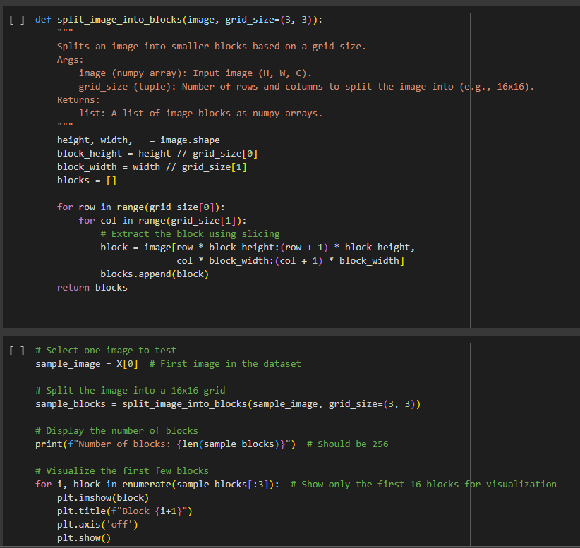
Attack Method – SIA
Color: Minimal changes to avoid altering the global appearance.
Texture: Limited adjustments to ensure surface consistency with the original input.
Perceptual Features: Modifications are made at a feature level to fool the model while preserving structure.
High-Level Features: Manipulates feature space representations without affecting the recognizable structure.
Perturbation Smoothness: Ensures perturbations are evenly distributed across the image to avoid noticeable artifacts.
Dr.Bakron

Slide 60
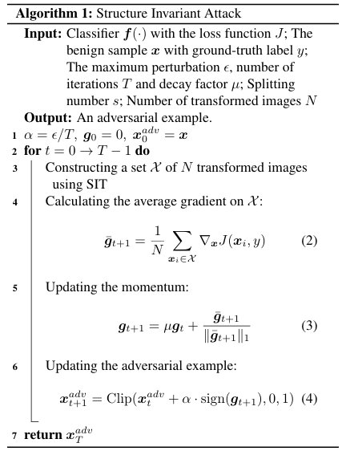
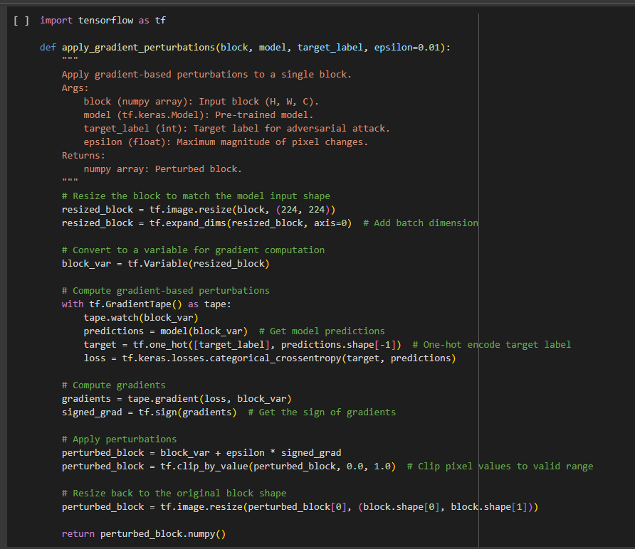
Attack Method – SIA
Dr.Bakron

Slide 61
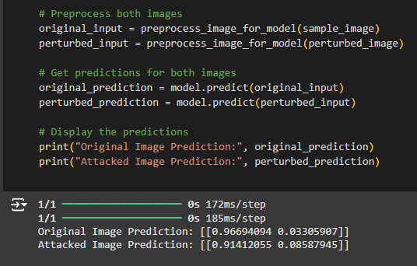
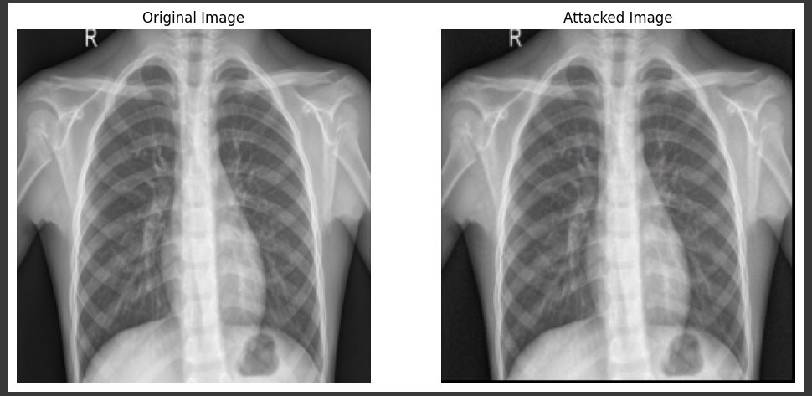
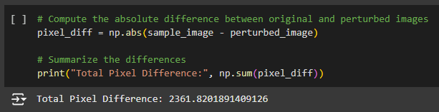
Attack Method – SIA
Dr.Bakron

Slide 62
Defence Strategies
Adversarial Training (AT)
Histogram Gradient Descent (HGD)
Randomized Smoothing (RS)
Randomized Noise Reduction and
Preprocessing (NRP)

Slide 63
Current Progress
1
Data Preprocessing
Image Preprocessing: Resized all images to the input size required by the model (e.g., 244x244 for DenseNet121)
Data Augmentation: Applied various augmentation techniques to improve model generalization
2
2
Model Setup
Model Setup
Trained Resnet50 (pretrained on ImageNet) to leverage powerful feature extraction capabilities.
Trained DenseNet121 (pretrained on ImageNet) to leverage powerful feature extraction capabilities.
3
Attack Simulation
Simulated SIA attack on CNN and shown misclassification after the attack.

Slide 64

Project Completion

Slide 65
References
[1] I. J. Goodfellow, J. Shlens, and C. Szegedy, "Explaining and harnessing adversarial examples," in Proc. Int. Conf. Learn. Representations (ICLR), San Diego, CA, USA, May 2015, pp. 1-11. [Online]. Available: https://arxiv.org/abs/1412.6572
[2] X. Yuan, P. He, Q. Zhu, and X. Li, "Adversarial examples: Attacks and defenses for deep learning," IEEE Trans. Neural Netw. Learn. Syst., vol. 30, no. 9, pp. 2805-2824, Sep. 2019. [Online]. Available: https://ieeexplore.ieee.org/document/8601309
[3] N. Papernot, P. McDaniel, I. J. Goodfellow, S. Jha, Z. B. Celik, and A. Swami, "Practical black-box attacks against machine learning," in Proc. 2017 ACM Asia Conf. Comput. Commun. Security (AsiaCCS), Abu Dhabi, United Arab Emirates, Apr. 2017, pp. 506-519. [Online]. Available: https://dl.acm.org/doi/10.1145/3052973.3053009
[4]A. Madry, A. Makelov, L. Schmidt, D. Tsipras, and A. Vladu, "Towards deep learning models resistant to adversarial attacks," in Proc. Int. Conf. Learn. Representations (ICLR), Vancouver, BC, Canada, Apr. 2018, pp. 1-18. [Online]. Available: https://arxiv.org/abs/1706.06083

Slide 66

IT21182600
W.N. Dilsara
Cyber Security

Slide 67
Robustness Evaluation of CNN Against Uniform Scale Mix Mask (USMM) Adversarial Attack
1
Introduction
2
Research Problem
3
Objectives
4
Literature Review
5
Methodology
5
Current Progress

Slide 68
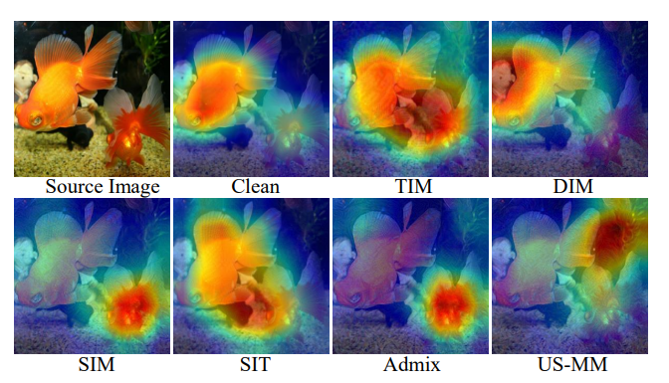
Introduction
What is USMM Attack?
The USMM attack changes the image size evenly and mixes it with parts of other images, making it look normal to humans but confusing to the model.

Slide 69
Research Gap
Lack of comprehensive evaluation of how Uniform Scale Mix Mask (USMM) impact CNN-based medical imaging systems.
Existing defense mechanisms have not been thoroughly tested for their effectiveness Uniform Scale Mix Mask (USMM) and model architectures.

Slide 70

Research Problem
How effective are existing defense strategies in enhancing the robustness of CNN models used for chest X-ray classification USMM adversarial attacks?
How can these defense strategies be tested and validated to ensure reliable and secure medical diagnostics?

Slide 71
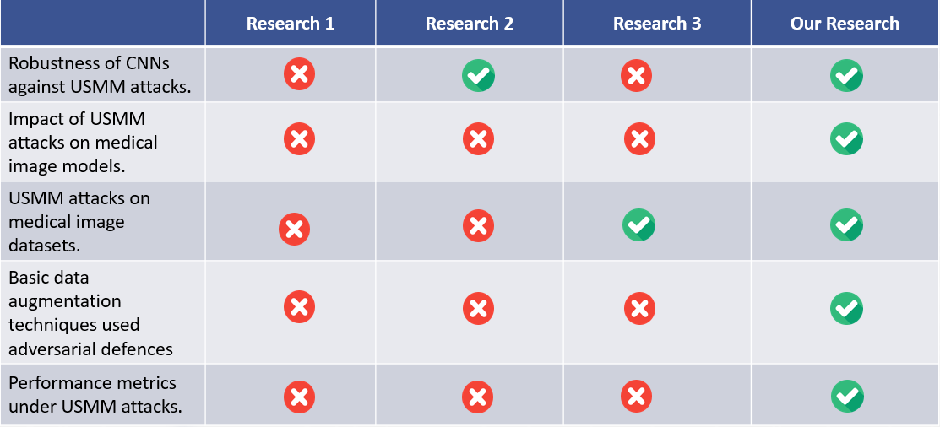
Literature Review
Gap

Slide 72
Objectives
1
Fine-Tune CNN
2
Implement USMM Attack
Fine-tune the CNN VGGNet19 models to evaluate their performance under USMM attack conditions.
Develop and apply the USMM attack on chest X-ray datasets using CNN model.
3
Evaluate Performance Metrics
4
Test Defence Strategies
Assess the impact of USMM attacks on model performance using metrics such as accuracy, precision, recall, and F1-score.
Test existing defense strategies, such as data augmentation and adversarial training, to mitigate the effects of USMM attacks on CNN models.
5
Validate Defence Effectiveness
Validate the effectiveness of the defense strategies by comparing model performance on clean and adversarial datasets.

Slide 73
Methodology
System Diagram
1
2
Technologies
3
4
Defense Strategies
Attack Method

Slide 74

System Diagram

Slide 75
Tools and Technologies
DL Frameworks
Model Architectures
TensorFlow
ResNet50
DenseNet121
VGG19
Inception V3
Programming Lang.
Data Management Tools
Visualization Tools
Python
Pandas
NumPy
Matplotlib
Evaluation Metrics
IDE & Compute Resources
Scikit-learn
Google Colab

Slide 76
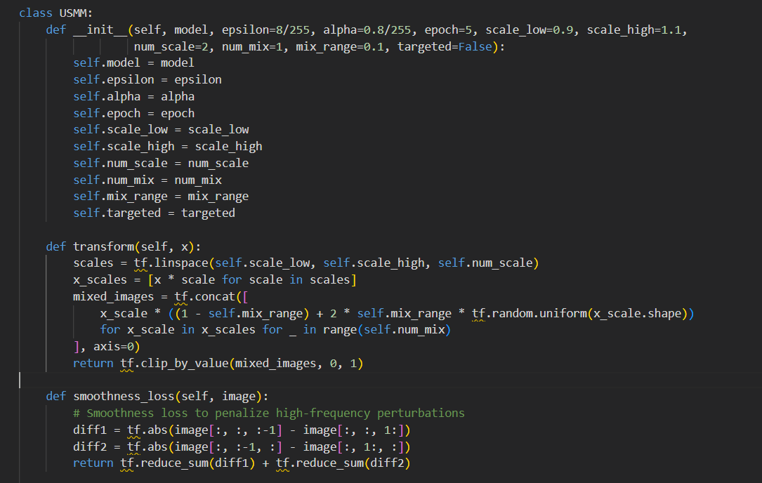
Attack Method – USMM
Initialization of Adversarial Image
Loop Over Epochs
Image Transformation
Scaling
Mixing
Loss Calculation
Model Prediction
Classification Loss
Smoothness Loss
Gradient Calculation and Update
Gradient Tape
Adversarial Update
Clipping
Dr.Bakron

Slide 77
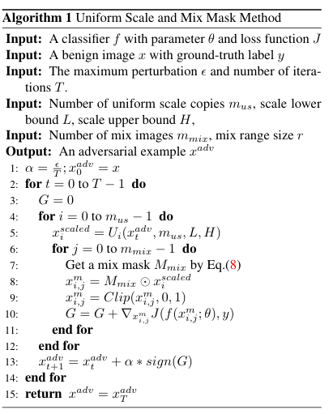
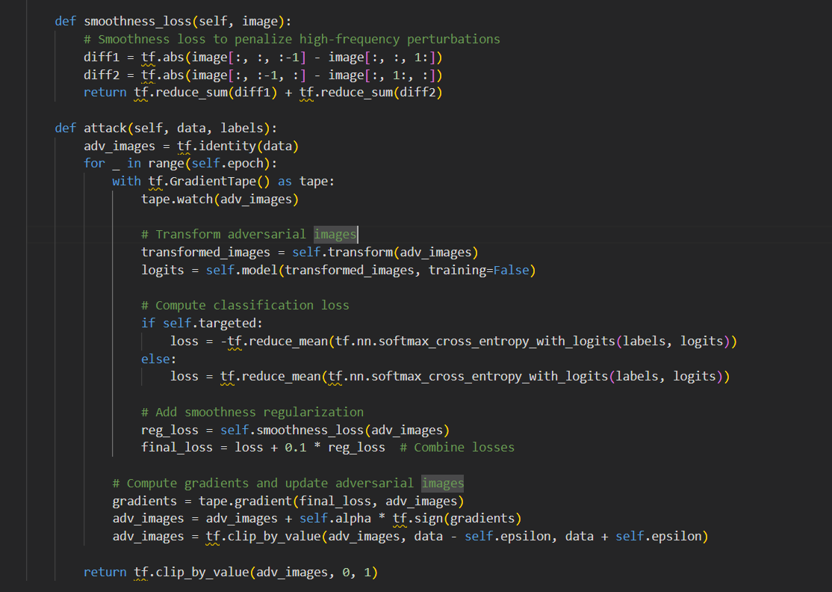
Dr.Bakron

Slide 78
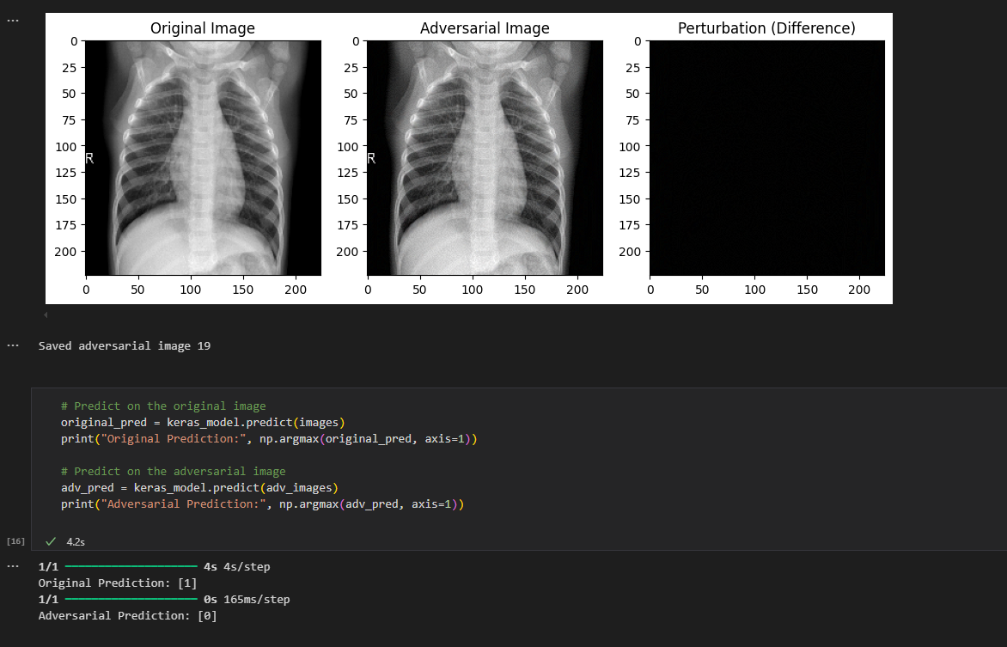
Dr.Bakron

Slide 79
Defence Strategies
Adversarial Training (AT)
Histogram Gradient Descent (HGD)
Randomized Smoothing (RS)
Randomized Noise Reduction and
Preprocessing (NRP)

Slide 80
Current Progress
1
Data Preprocessing
Image Preprocessing: Resized all images to the input size required by the model
Data Augmentation: Applied various augmentation techniques to improve model generalization
2
2
Model Setup
Model Setup
Trained Resnet50 (pretrained on ImageNet) to leverage powerful feature extraction capabilities.
Trained VGGNet19 (pretrained on ImageNet) to leverage powerful feature extraction capabilities.
3
Attack Simulation
Simulated USMM attack on CNN and shown misclassification after the attack.

Slide 81
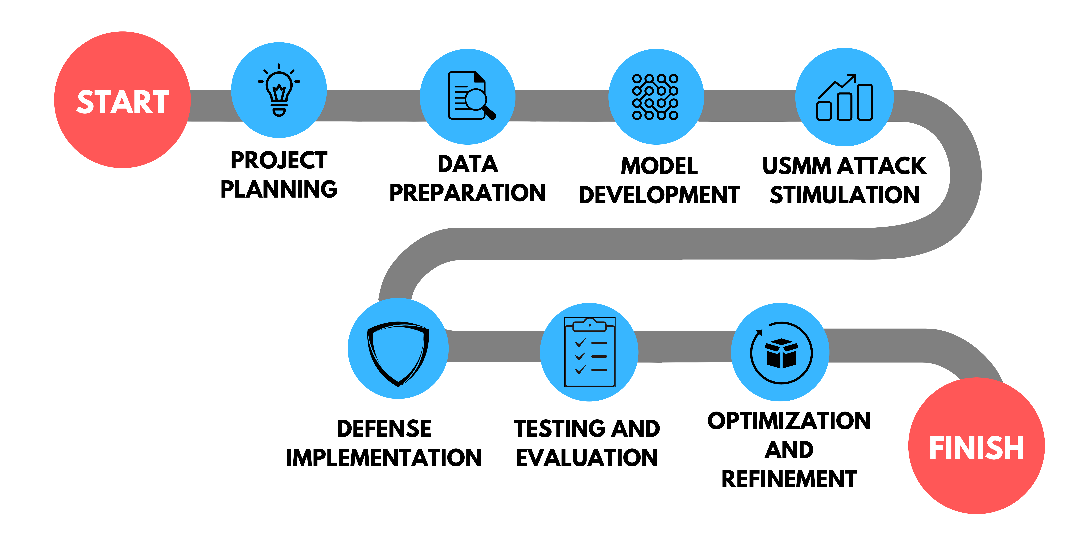
Project Completion

Slide 82
References
[1] Tao Wang, Zijian Ying, Qianmu Li, and Zhichao Lian, "Boost Adversarial Transferability by Uniform Scale and Mix Mask Method," arXiv preprint arXiv:2311.12051v1, 2023.
[2] Arjun Nitin Bhagoji, Warren He, Bo Li, and Dawn Song, "Practical Black-box Attacks on Deep Neural Networks using Efficient Query Mechanisms," in Proceedings of the European Conference on Computer Vision (ECCV), 2018, pp. 154-169.
[3] N. Akhtar, "Addressing the Transferability Gap in Universal Adversarial Perturbations," arXiv preprint arXiv:2210.05968, 2022.

Slide 83
Thank You

